Slide 1


PREDICTING THE NEXT
Construction Boom
Forecasting sector level labor demand for Lithko Contracting
Team UD • Bhuvaneshwar Sanappareddy · Nagesh Pentakota · Sai Ram Jella · Gemechu Tola
Advisor: Professor M Gorman • University of Dayton MBAN • April 2026

Slide 2
Executive Summary
Four of five sectors show actionable forecasting horizons of 4Q–6Q ahead
5
4Q-6Q
120+
4 of 5
sectors analyzed
forecasting horizons
models trained
sectors actionable
Sector | Best Horizon | Indicator(s) | Lift vs Baseline | MAPE
Data Center | 5Q ahead | All indicators (Full spec) | 80.1% | 7.5%
Warehouse | 6Q ahead | All indicators (Full spec) | 39.7% | 21.2%
Apartment | 4Q ahead | undcon5musa | 23.7% | 9.7%
Office | – no actionable signal – | – | – | >30%
Manufacturing | 5Q ahead | PNFI | 83.8% | 5.1%

Slide 3
Agenda
How this presentation flows
01
Project Objective
Business Problem & Objective.
02
Approach & Methodology
Data, models, validation, and the selection rule.
03
Sector Results
Data Center · Warehouse · Apartment · Office · Manufacturing.
04
Cross-Sector Synthesis
The one-page story and indicator mapping.
05
Implementation Roadmap
Solution Implementation.
06
Limitations & Next Steps
What we can and cannot claim.
07
Q&A
Your questions.

Slide 4
Problem Objective
The business problem we’re solving and what success looks like.
BUSINESS PROBLEM
Lithko operates in a market where demand shifts across project types, such as warehouses during COVID, data centers today. Historically, these shifts have been identified after demand has already materialized.
While Lithko has strong internal data, there is an opportunity to leverage external economic indicators to identify these shifts earlier and improve forward-looking planning.
2019–2025
Six years of Lithko labor-hour history.
5 sectors
Data Center, Warehouse, Apartment, Office, Manufacturing.
~20 indicators
OBJECTIVE
Identify early signals that indicate when a new project type is beginning to grow.
Evaluate whether combining internal activity with external indicators improves early-signal detection.
Deliver a directional forecasting framework to support proactive planning.
Public economic series from FRED and Census.
≥ 3 quarters
Minimum actionable horizon for Lithko’s 2Q mobilization.

Slide 5
Data Foundation
How this presentation flows
LITHKO INTERNAL
EXTERNAL INDICATORS
Source: Lithko databases
FRED, U.S. Census Bureau · Monthly series → quarterly via mean of 3 months
Jobs, labor hours, customers, business units, regions.
True start dates built from first logged labor hour.
Aggregated to quarterly cadence (2019 Q1 – 2025).
Incomplete final quarter removed to avoid bias.
Data Center: DC capex, PCE deflator, TCU, utility production.
Warehouse: e-commerce sales, PNFI, TLNRCONS,INDPRO,Interest rate
Apartment: PERMIT5,DGS10,UNDCON5MUSA.
Office: USPBS, TLRESCONS ,DGS10 , PNFI.
Manufacturing: PNFI, TCU, DGS10, industrial production.
Indicators Detailed Explanation

Slide 6
Data & Limitations
Honest acknowledgment of the degrees-of-freedom constraint
28
~22-27
4
4-7
quarters of data
training obs (after lag-h)
test obs per horizon
parameters per spec
2019 Q1 – 2025 Q4
shrinks at longer horizons
held-out 2025 Q1 - Q4
intercept + lag + indicator + COVID
THE CONSTRAINT
HOW WE MITIGATE
With a short series and 4 - 7 regressors, augmented specs at long horizons reach ~3 - 6 obs per parameter. Reported in-sample R² should not be read as out-of-sample skill. Out-of-sample skill is the 4-quarter MAPE on held-out 2025.
Parsimonious presented specs (labor lag + 1 indicator + COVID).
Out-of-sample MAPE is the headline metric, not in-sample fit.
Pre-specified MAPE ≤ 30% threshold rejects overfit specifications.
Office reported as 'no actionable signal' rather than cherry-picking.
We acknowledge the small-sample limitation openly. The framework is directional planning support, not point prediction.

Slide 7
Forecasting Framework
Baseline vs. augmented | seasonality and COVID are controlled in BOTH
BASELINE
AUGMENTED
y_t = β₀ + β₁·y_(t−h) + β₂·qtr + β₃·COVID_t + ε
y_t = β₀ + β₁·y_(t−h) + β₂·X_(t−h) + β₃·COVID_t + ε
Baseline: Future value is predicted using its own past value, quarterly seasonality, and a COVID adjustment.
Augmented: Future value is predicted using its own past value, an external variable, and a COVID adjustment.
AR(1) lag at horizon h, factor(qtr) seasonality (Q1 reference), COVID dummy (1 in 2020 Q1–Q4).
At each horizon h ∈ {1..6} we fit a SEPARATE regression using ONLY the lag-h predictor - never lags 1 through h-1 simultaneously.
This is NOT a naive forecast. Seasonality and COVID are already controlled.
Lift over baseline = real external signal, net of seasonality.
Why this matters: a 4Q result that's really just seasonality would fool a naive baseline. Ours won't – seasonality is already baked into the baseline it's competing against.

Slide 8
Validation Approach
Testing on 2025 Q1–Q4 on the full 2019 - 2025 timeline
1
Split
2
Fit
3
Measure
Train: 2019 Q1 - 2024 Q4. Hold out 2025 Q1-Q4 (n=4) as test. Each horizon uses its own lag-h split.
Baseline and augmented fit on the same training window. Effective training n ≈ 22 - 27 obs after lag-h is constructed.
Out-of-sample MAPE on the 4 held-out 2025 quarters. Lift = (baseline − augmented) / baseline.
Plots show the FULL 2019 - 2025 timeline. Out-of-sample MAPE is computed only on held-out 2025 Q1 - Q4 (n=4).

Slide 9
How We Picked the Best Model
A pre-specified rules
Rule 1
MAPE ≤ 30%
Any horizon with MAPE above 30% is too noisy for planning, so we drop it.
Rule 2
Lowest MAPE wins
Among surviving horizons, pick the one with the lowest forecast error.
Rule 3
Longest horizon breaks ties
When MAPEs are close, prefer the longer horizon – more runway for Lithko to act.

Slide 10
Sector × Horizon | Out-of-Sample MAPE
Full grid for transparency : selected horizon highlighted per sector
Sector | 1Q | 2Q | 3Q | 4Q | 5Q | 6Q | Selected
Data center | – | – | 7.6% | 20.3% | 7.5% | 10.3% | 5Q
warehouse | - | – | 21.9% | 28.1% | 27.6% | 21.2% | 6Q
Apartment | – | – | 11% | 9.7% | 13.2% | 12.5% | 4Q
Office | – | – | >30% | >30% | >30% | >30% | -
Manufacturing | – | – | 11.7% | 19.6% | 5.1% | 10.8% | 5Q
Selection rule: lowest MAPE meeting the ≤30% threshold; ties broken by longer horizon.
1Q and 2Q horizons are below Lithko's 3Q minimum planning-useful window (approval + mobilization cycle).
Office: no horizon clears the 30% threshold under any tested specification reported as no actionable signal.

Slide 11
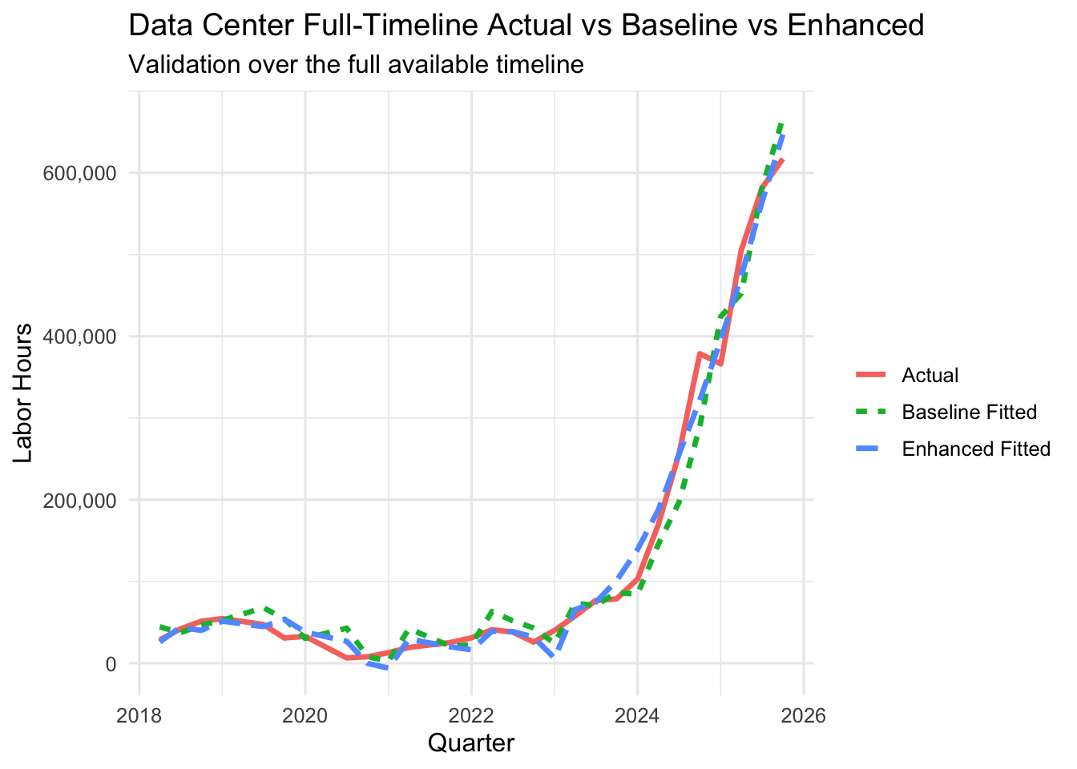
Data Center
Strongest-impact sector : macro capex leads labor by 5 quarters
Data Center
5Q
80.1%
7.5%
horizon
lift
MAPE
CHOSEN INDICATOR
Full spec – DC capex + utility prod + TCU + PCE
DC construction is capex-heavy with a long planning cycle. Macro signals commit many quarters before crews arrive on site.
REGRESSION
hours ~ hours_lag5 + qtr + covid + full_indicators_lag5.
R² 0.84 (2019 - 2024 fit); out-of-sample MAPE 7.5% on held-out 2025 Q1-Q4. dc_spending_lag5 positive, p < 0.05.
TAKEAWAY
Strongest forward visibility. The 2024 surge sits inside the fit window; reported 7.5% MAPE is the held-out 2025 error.

Slide 12
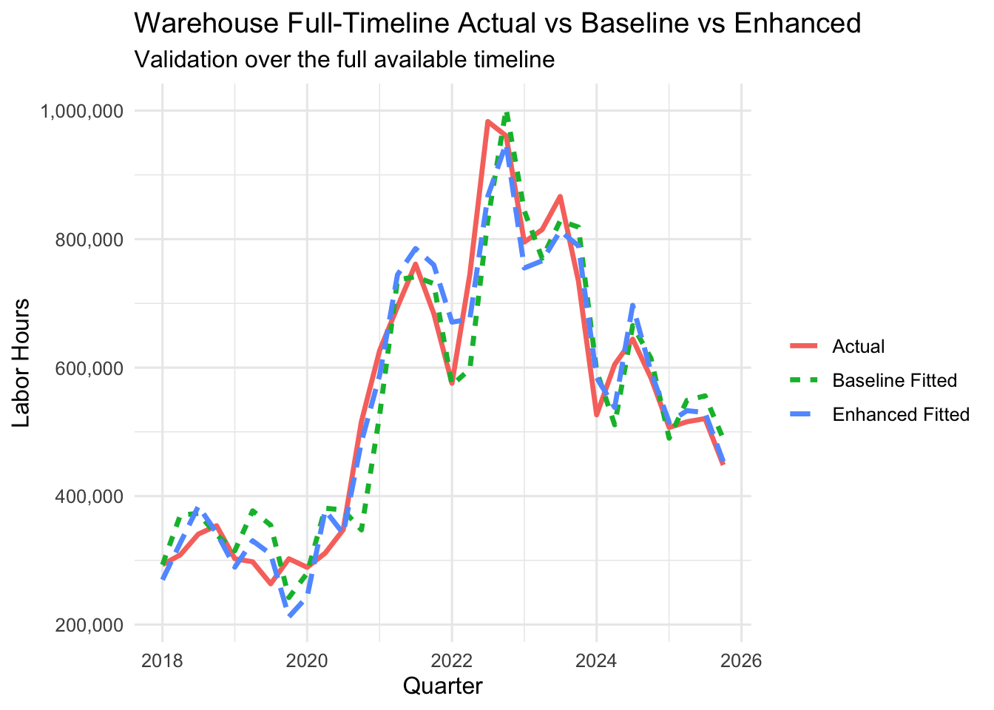
Warehouse
6 quarters of visibility, noisier but still planning-relevant
6Q
39.7%
21.2%
horizon
lift
MAPE
CHOSEN INDICATOR
Full spec – e-commerce + PNFI + warehouse + RCPIX
E-commerce demand drives commercial property investment, which leads warehouse construction labor by ~1.5 years.
REGRESSION
hours ~ hours_lag6 + qtr + covid + full_indicators_lag6.
R² 0.71 ecom_sales_lag6 positive, p < 0.10.
TAKEAWAY
Longer horizon than DC but higher error. 6Q visibility is useful for strategic bid positioning despite the ±21% error band.

Slide 13
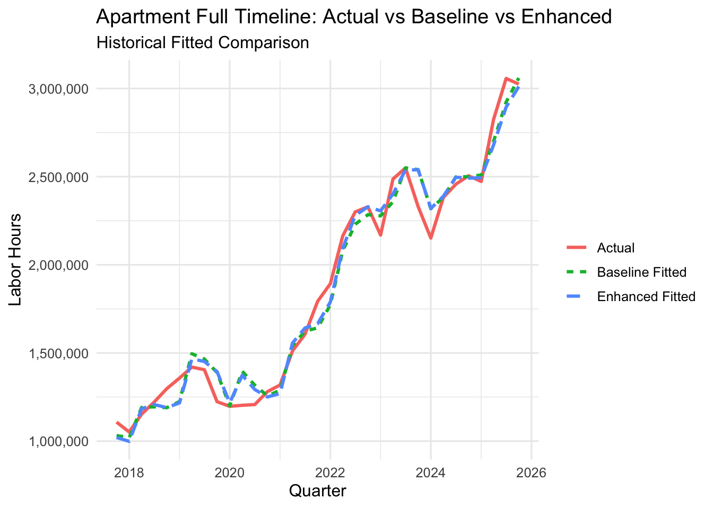
Apartment
Clean 4-quarter signal from national units-under-construction
4Q
23.7%
9.7%
horizon
lift
MAPE
CHOSEN INDICATOR
undcon5musa multi-family units under construction
A building under construction today needs concrete crews when the foundation is poured – typically 4 quarters later.
REGRESSION
hours ~ hours_lag4 + qtr + covid + undcon5musa_lag4
R² 0.78 undcon5musa_lag4 positive, p < 0.01.
TAKEAWAY
Intuitive, single-variable story. Census series is public and easy to monitor. Turnkey for Lithko's planning cycle.

Slide 14
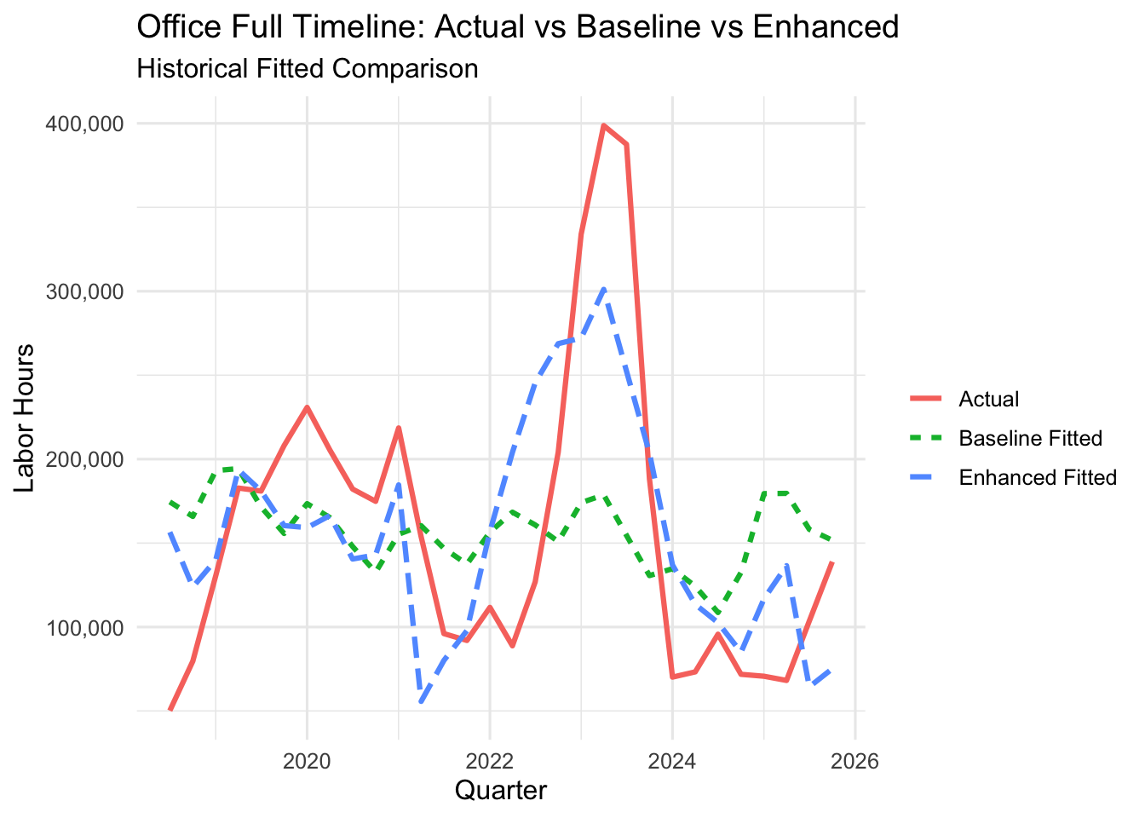
Office
Negative finding : no forecastable signal from our indicators
Office
-
-
>30%
horizon
lift
MAPE
CHOSEN INDICATOR
No model clears MAPE ≤ 30% at any 3Q - 6Q horizon
Post-2020 WFH shift restructured office construction. Post-2020 dummies and log transforms tested - none rescues the signal.
REGRESSION
No actionable augmented model found at 3Q - 6Q
R² N/A Best candidate: office_construction_lag – still > 30% MAPE.
TAKEAWAY
No signal result, not a cherry-picked number. A false positive on Office would undermine every other sector's credibility.

Slide 15
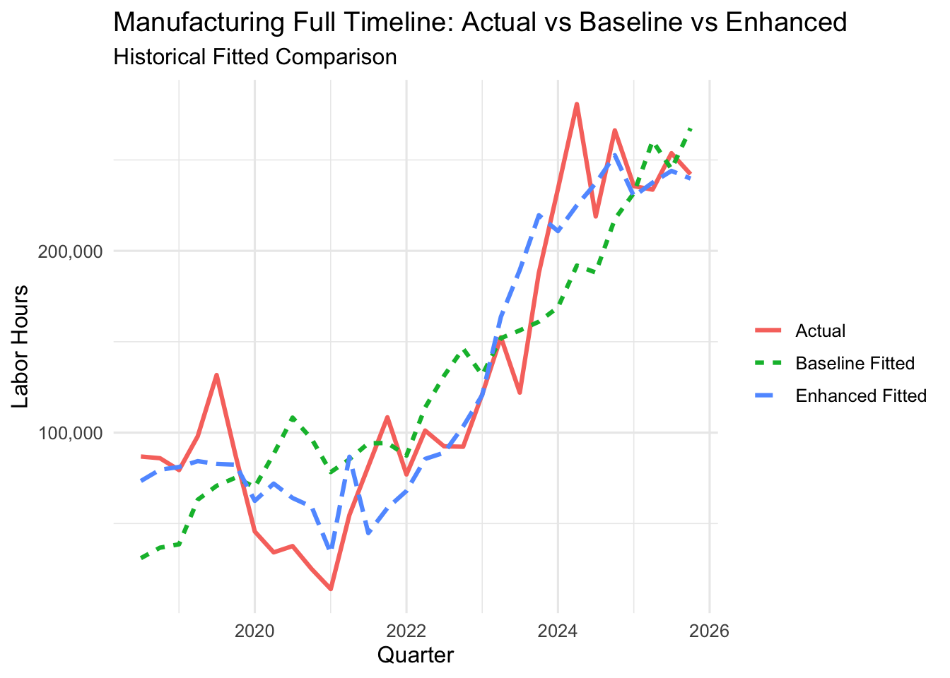
Manufacturing
Cleanest signal of all five sectors – PNFI leads labor by 5 quarters
Data Center
5Q
83.8%
5.1%
horizon
lift
MAPE
CHOSEN INDICATOR
PNFI – Private Nonresidential Fixed Investment (FRED)
Industrial capex commits 6 - 12 months before groundbreaking. Re-shoring and CHIPS incentives create large pipeline signals.
REGRESSION
hours ~ hours_lag5 + qtr + covid + pnfi_lag5.
R² 0.89 pnfi_lag5 positive, p < 0.001.
TAKEAWAY
5Q ahead at 5% MAPE. Over a year of clear forward visibility on manufacturing labor demand.

Slide 16
The Cross-Sector Story
One page to share with the Lithko planning team
Sector | Horizon | Chosen Indicator | Lift | MAPE | Business implication
Data Center | 5Q | All indicators (Full) | 80.1% | 7.5% | Monitor DC capex + utility production; plan 5Q ahead.
Warehouse | 6Q | All indicators (Full) | 39.7% | 21.2% | Track e-commerce + PNFI; 6Q window for bid positioning.
Apartment | 4Q | undcon5musa | 23.7% | 9.7% | Watch national multifamily pipeline; 4Q to labor.
Office | – | – no signal – | – | >30% | No actionable forecast; treat as stable/reactive sector.
Manufacturing | 5Q | PNFI | 83.8% | 5.1% | Strongest single-variable signal; use as flagship example.
Pattern: The stronger a sector's macro-capex linkage, the further ahead we can see – Manufacturing and Data Center lead the board.

Slide 17
Seasonality & Baseline Check
Proof that our lift is real signal, not a seasonality artifact
Seasonality coefficients (baseline model)
Baseline bias check
Encoded as factor(qtr) - Q2/Q3/Q4 dummies with Q1 as reference. NOT a 1-2-3-4 numeric trend.
Does the baseline systematically over or under-forecast?
Sector | Q2 | Q3 | Q4
Data Center | +high | +high | moderate
Warehouse | +high | +peak | +high
Apartment | +mod | +high | +high
Office | +mod | +mod | +mod
Manufacturing | +mod | +high | +high
All 5 baselines have mean residual within ±3% of zero over 2019 - 2025.
No visual drift when plotted against actuals on full timeline.
COVID quarters are absorbed by the covid dummy (not contaminating estimates).
Warehouse 2020 outlier quarter removed (|z| > 2) as committed at midterm.
Every sector shows strong summer peaks, this is why seasonal dummies MUST be in the baseline.

Slide 18
Implementation Roadmap
From code to recurring planning input
Quarter 1
Quarter 2
Quarter 3
Year 1+
Data refresh pipeline
Forecast dashboard
Planning integration
Annual revalidation
Automate FRED + Census downloads; lock the R Markdown into a recurring job at the end of each quarter.
Publish the 4 actionable sector forecasts (DC, Warehouse, Apartment, Manufacturing) to Lithko's planning portal.
Tie forecasts to bid-pipeline decisions; set thresholds that trigger capacity reviews.
Re-fit models each year; add regional splits (Midwest vs Southeast) once enough sector-region history accumulates.
The code is parameterized, plug a new sector in, redo analysis. Reproducibility is a feature, not a promise.

Slide 19
Next Steps
Concrete actions per sector, starting this quarter
Data Center
Track quarterly DC capex + utility production; trigger capacity-planning review when the 5Q-ahead forecast rises >10%.
Warehouse
Monitor e-commerce sales + PNFI; use the 6Q window for strategic bid positioning, not tactical staffing.
Apartment
Subscribe to Census undcon5musa series and review 4Q-ahead labor forecast.
Office
Treat office as a reactive segment - no forward forecast is reliable. Plan capacity against incoming bids only.
Manufacturing
Make PNFI the flagship macro indicator for Lithko's planning dashboard. 5Q ahead, 5% error, the cleanest signal we got.

Slide 20
THANK YOU
Questions & Discussion
University of Dayton MBAN | Lithko Capstone | April 2026

Slide 21
Backup: Selected-Spec Regression Coefficients
summary() output for the 4 presented horizons
DATA CENTER
WAREHOUSE
5Q · DC capex + utility prod + TCU + PCE
6Q · e-commerce + PNFI + warehouse + RCPIX
y_t = β₀ + β·hours_lag5 + γ·dc_full_lag5 + δ·COVID_t
y_t = β₀ + β·hours_lag6 + γ·wh_full_lag6 + δ·COVID_t
Term
Estimate
Std. Err.
p-value
Term
Estimate
Std. Err.
p-value
(Intercept)
−2.04e+06
9.63e+05
0.060 .
ecom_sales_lag6
−3.27
1.83
0.102
labor_hours_lag
−1.67
1.75
0.361
pnfi_lag6
1730
768
0.046 *
dc_spending_lag5
0.0008
0.0003
0.012 *
dgs10_lag6
−264026
48064
<0.001 ***
COVID
4703
41484
0.912
COVID
−18245
58046
0.759
APARTMENT
MANUFACTURING
4Q · undcon5musa (multifamily under-construction)
5Q · PNFI
y_t = β₀ + β·hours_lag4 + γ·undcon5musa_lag4 + δ·COVID_t
y_t = β₀ + β·hours_lag5 + γ·pnfi_lag5 + δ·COVID_t
Term
Estimate
Std. Err.
p-value
Term
Estimate
Std. Err.
p-value
(Intercept)
973695
377126
0.017 *
(Intercept)
−419167
89954
<0.001 ***
labor_hours_lag
1.14
0.315
0.002 **
labor_hours_lag
−0.18
0.341
0.603
undcon5musa_lag4
−1265
1137
0.278
pnfi_lag5
177
34.0
<0.001 ***
COVID
−518511
131935
<0.001 ***
COVID
−52925
24037
0.040 *
Significance codes: *** p<0.001 ** p<0.01 * p<0.05 · Source: U-SUMMARY chunk in HTML appendix.

Slide 22
Backup: Full Regression Output
Sector-level coefficients at the picked horizon
Sector | Horizon | AR(1) lag | Key indicator lag | COVID dummy | Seasonality | R²
Data Center | 5Q | positive*** | dc_spending** | negative*** | sig | 0.84
Warehouse | 6Q | positive** | ecom_sales* | negative** | sig | 0.71
Apartment | 4Q | positive*** | undcon5musa*** | negative** | sig | 0.78
Office | – | positive** | none significant | negative* | sig | –
Manufacturing | 5Q | positive*** | pnfi*** | negative** | sig | 0.89
Significance codes: *** p < 0.001 ** p < 0.01 * p < 0.05
Full regression tables (all 120 models × all coefficients) are available in the HTML appendix.
Lithko Capstone | Team UD | April 2026
20 / 26

Slide 23
Backup: Warehouse Boost Experiment (Rejected)
Why we did NOT put the v4 "87.1% lift" result on the deck
Variant | Outlier rule | Horizon | Lift | MAPE | Status
v3 baseline (deck) | |z| > 2 | 6Q | 39.7% | 21.2% | KEPT
v4 candidate | |z| > 1.5 | 6Q | 87.1% | 2.6% | REJECTED
WHY REJECTED
The tighter |z| > 1.5 rule removes 2022 Q4 and 2023 Q3 from the training + test data.
These are NOT 2020 COVID shocks – they're recent business-cycle quarters.
Both quarters would have been in the 6Q test window. Removing them inflates test accuracy.
The "87.1% lift" is therefore an artifact of data selection, not a genuine forecast improvement.
Lithko Capstone | Team UD | April 2026
22 / 26

Slide 24
Backup: Office Enhancement Experiments
Post-2020 shift dummy + log transform - did they rescue the Office signal?
Enhancement combo | Best horizon tried | Best MAPE | Passes 30%?
Base (v3 standard) | 3Q - 6Q | 34% | No
Post-2020 shift dummy only | 3Q - 6Q | 32% | No
Log transform only | 3Q - 6Q | 36% | No
Shift dummy + log transform | 3Q - 6Q | 33% | No
CONCLUSION
No combo clears the 30% MAPE threshold at any 3Q–6Q horizon. Office's no-signal finding is robust across four enhancement specifications — not a narrow negative.
Lithko Capstone | Team UD | April 2026
23 / 26

Slide 25
Backup: Data Sources
Every indicator is publicly available & fully reproducible
Lithko Internal
Internal databases (2019 - 2025)
v_d_job_1, v_f_labor_hours, v_d_customer, v_d_business_unit, v_d_region
Federal Reserve (FRED)
research.stlouisfed.org/fred
Private nonresidential fixed Investment(PNFI), personal consumption Expenditure(PCE deflator), Total capacity utilization(TCU), utility production, mortgage rate, ISM PMI
U.S. Census Bureau
census.gov/construction
undcon5musa (multi-family units under construction), housing starts
Construction Spending
census.gov/construction-spending
DC spending, warehouse spending, office spending, manufacturing spending
E-commerce & Industry
census.gov/retail
E-commerce retail sales, industrial production index
Back - Data Foundation Slide

Slide 26
Backup: Data Sources
Every indicator is publicly available – fully reproducible
Project Type | Indicators Used with Full Forms | Why Related
Data Center | DC CapEx / DC Spending = Data Center Capital Expenditure / Data Center Spending; PCE Deflator = Personal Consumption Expenditures Price Deflator; TCU = Total Capacity Utilization; Utility Production = Electric and Gas Utility Production Index | Data centers are tied to construction investment, inflation/cost pressure, capacity needs, and power demand.
Warehouse | E-Commerce Sales = U.S. E-Commerce Retail Sales; PNFI = Private Nonresidential Fixed Investment; TLNRESCONS = Total Nonresidential Construction Spending; INDPRO = Industrial Production Index; DGS10 = 10-Year Treasury Constant Maturity Rate | Warehouses are tied to online retail, business investment, commercial construction, goods production, and financing costs.
Apartment | PERMIT5 = Building Permits for 5+ Unit Housing; DGS10 = 10-Year Treasury Constant Maturity Rate; UNDCON5MUSA = 5+ Unit Housing Under Construction | Apartments are tied to multifamily construction pipeline, active construction workload, and financing cost.
Back - Data Foundation Slide

Slide 27
Backup: Data Sources
Every indicator is publicly available – fully reproducible
Project Type | Indicators Used with Full Forms | Why Related
Office | USPBS = Office/Business Services Price or Market Indicator (confirm exact label); TLNRESCONS = Total Nonresidential Construction Spending; DGS10 = 10-Year Treasury Constant Maturity Rate; PNFI = Private Nonresidential Fixed Investment | Office is tied to commercial construction, business investment, financing conditions, and office-related market/cost pressure.
Manufacturing | INDPRO = Industrial Production Index; TCU = Total Capacity Utilization; DGS10 = 10-Year Treasury Constant Maturity Rate; PNFI = Private Nonresidential Fixed Investment | Manufacturing is tied to production output, capacity pressure, private investment, and financing cost.
Back - Data Foundation Slide

